Slide 1
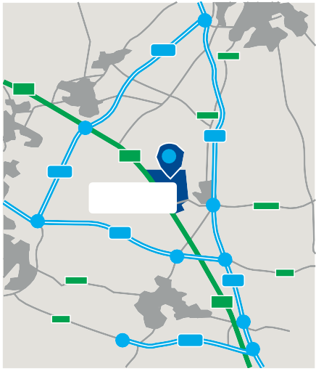
M69 J1
PLOT G
21
A5
F
M69
A426
Y
G
MERE LANE
A5
A
W
Y
S
A426
1
AR
G
O
1
M1
A5
M69
ADC
BLVD.
MAGNA PARK LUTTERWORTH
M6
20
LUTTERWORTH
H
Unit 5320 (Vacant)
A4303
HUNTER
MERE LANE
2
1
M6 J1 & M1 J18
A4303
N WAY
CDC
E
VULCA
A428
19
M1
A5
18
A14
.
A5
D
V
RUGBY
L
R
B
E
T
H
U
N
WAY
A45
A
XPO
1
M45
E
17
K
W
W
HUNTE
HA
IDC
C
E
R
L
B
B
Bus Stops
LI
L
V
D
OVENT
N
WELLINGTON PARKWAY
.
G
T
BUCCA
D
RY
ON
ROAD
SHACKLETON WAY
PARKW
NEE
R W
Bus Route
AY
A
Y
WELLINGTON PARKWAY
A4303
ESTATE OFFICE
HARRIER PARKWAY
C
LUTTERW
HARRIER PARKWAY
Magna Park Management The Estate Office Harrier Parkway
Magna Park, Lutterworth Leicester LE17 4XT
T: 01455 247541
Unit 2400 (Vacant)
M1 J20
ORTH BYPASS

